Slide 1

MIS
6380.501
Final Project
Group-10
Exploring the relationship between
comorbidities and other conditions with
the number of COVID-19 deaths in USA
from 2020 to 2023.

Slide 2

THE TEAM
Ruthvika Korrapati
kxn210050
Nihal Darak
nxd220015
Harish K
hxr210030
Kruthagama Divakar
kxd220014
Jacob Mathew
jxm220007

Slide 3

Overview
The Primary dataset shows the number of COVID-19 deaths and
the underlying medical conditions among Americans who
eventually died due COVID. We are going to utilize this data
along with a few other secondary datasets to better understand
how factors such as immunity, pre-existing conditions,
population density, climate and vaccinations affected the
severity of the disease.
Number of Records:
Data Cleansing Tool:
Visualisation Tool:
The Primary Data Set has
5,34,061 observations.
MS-Excel
Tableau

Slide 4
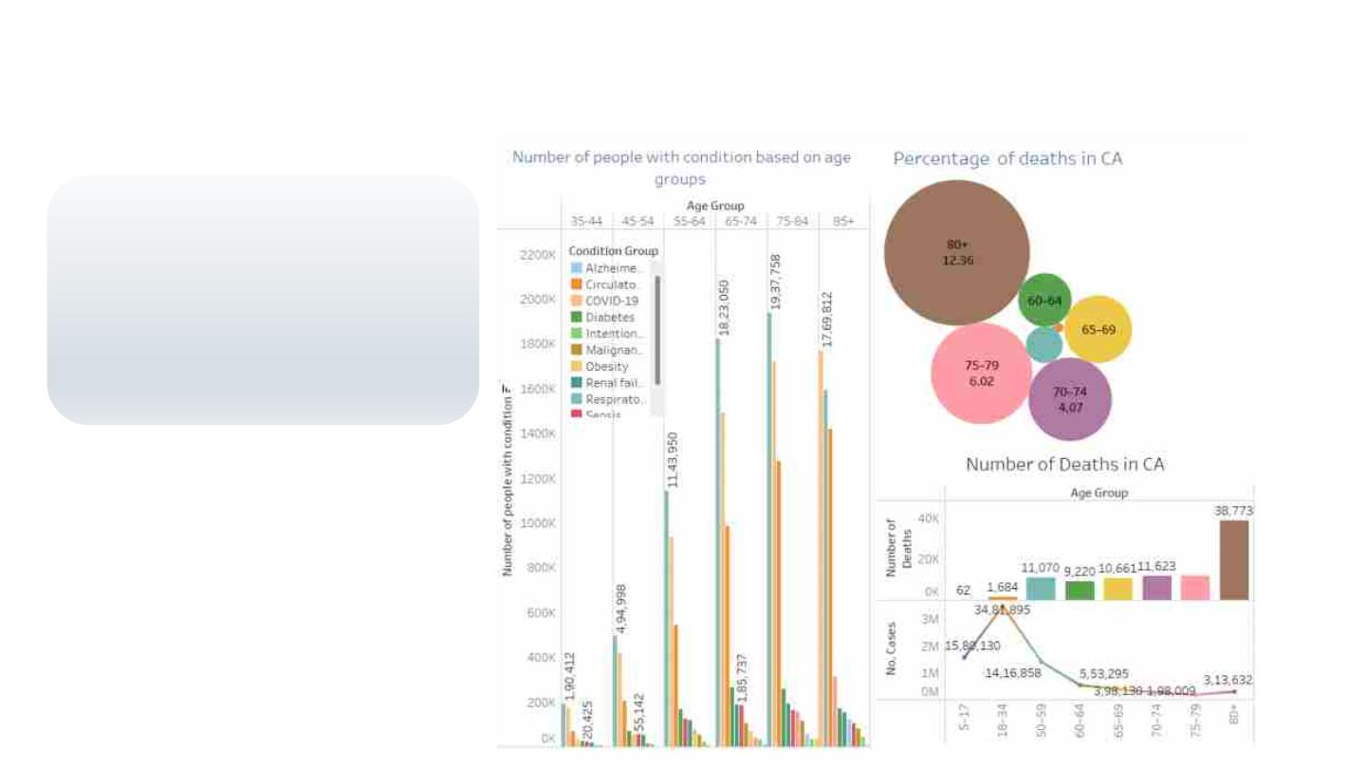
Hypothesis-1
Individuals aged 75 and above in
California had elevated mortality
rate due to COVID compared to
any other age group because of
their relatively weaker immune
systems.

Slide 5

Hypothesis-1
Final Verdict
We all know that age is a major cause
of various diseases, we can see that
as age increases , the number of
diseases increases.
Thus our hypothesis is
proved TRUE. Age 75 and
above had more deaths
due to weaker immune
system
Age and immune system are inversely
proportional, i.e. With increase in age
the immune system gets weaker.
We see that in spite of the number of
cases being higher for the age group
18-34, the deaths are highest for the
age group 80+

Slide 6
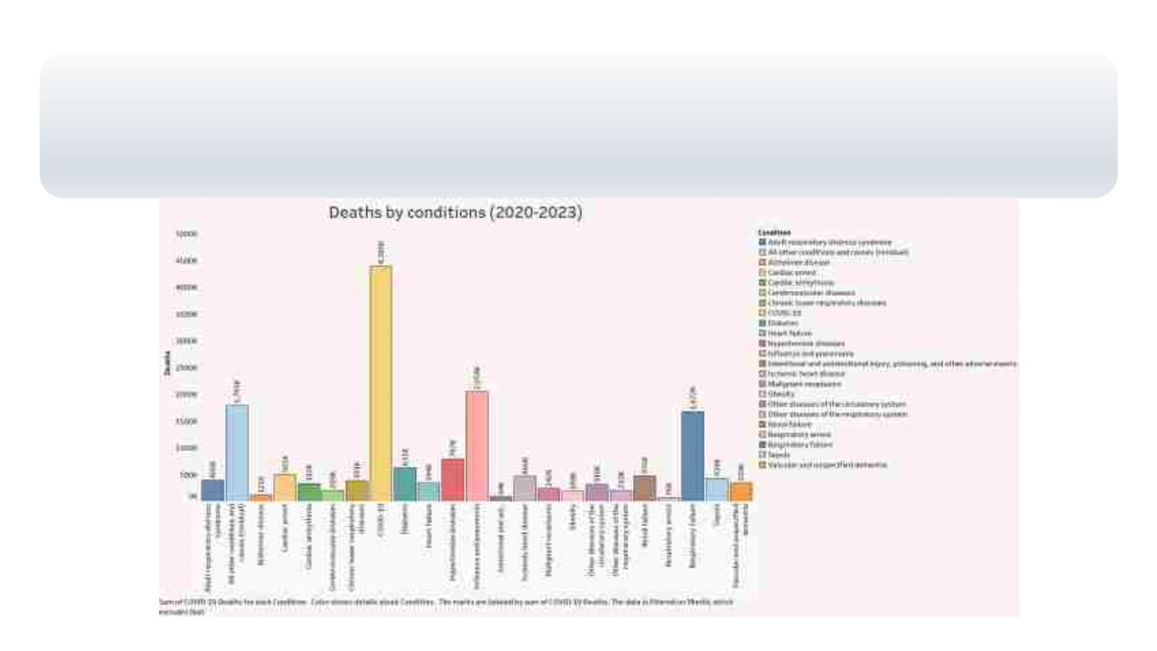
Hypothesis-2
The general trend shows most Americans died due to Heart Diseases, but between 2020 and 2023,
majority of Americans died due to Respiratory diseases because COVID was at it peak and COVID virus
caused respiratory problems

Slide 7
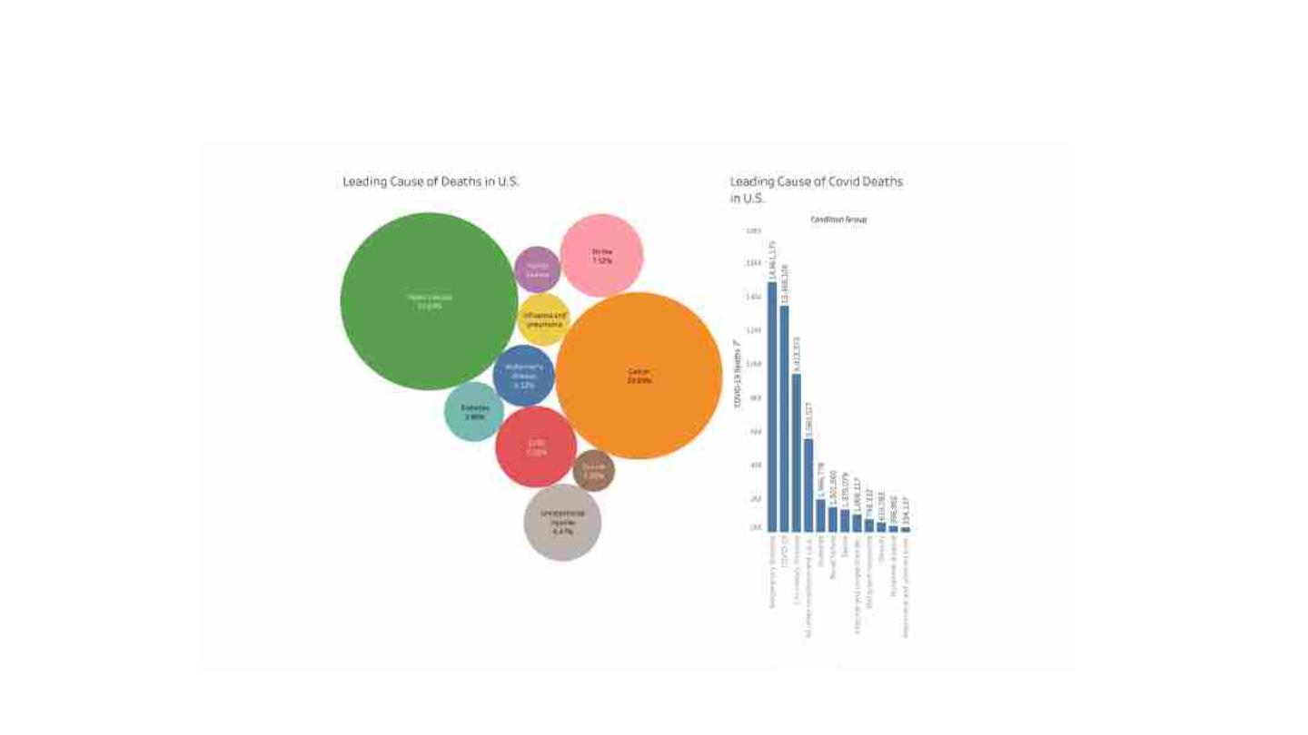
Hypothesis-2

Slide 8
Hypothesis-2
Final Verdict
33% of Americans died due to heart
disease every year. It took more life’s
than any other conditions
Our hypothesis is proved
TRUE. Since individuals
respiratory system was
affected by COVID.
Respiratory disease took
over as major contributor to
death among Americans
than Heart Diseases
However between 2020 and 2023, The
majority of deaths in US was caused
by COVID
COVID affected ones respiratory
system therefore Respiratory diseases
caused more deaths from 2020-2023
than heart diseases

Slide 9
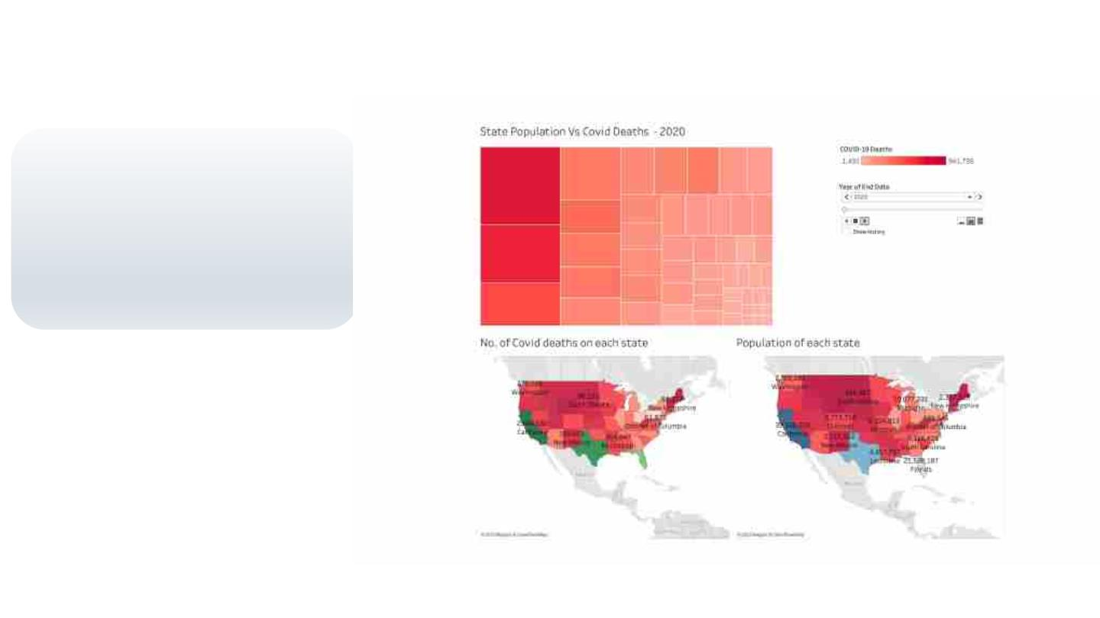
Hypothesis-3
California and Texas
have more covid deaths
when compared to other
states because
the population of
California and Texas is
high.

Slide 10
Hypothesis-3
Final Verdict
California and Texas are two of the
most populous states in the United
States
Our hypothesis is proved
TRUE. Since COVID
spread through close
contact among
individuals, the states
with highest population
also saw the highest
number of covid deaths
High population can increase the
likelihood of virus transmission, which
could lead to higher numbers of cases
and deaths.
Over the years between 2020 and
2023 we see that Texas and California
had the highest number of covid
deaths in USA

Slide 11
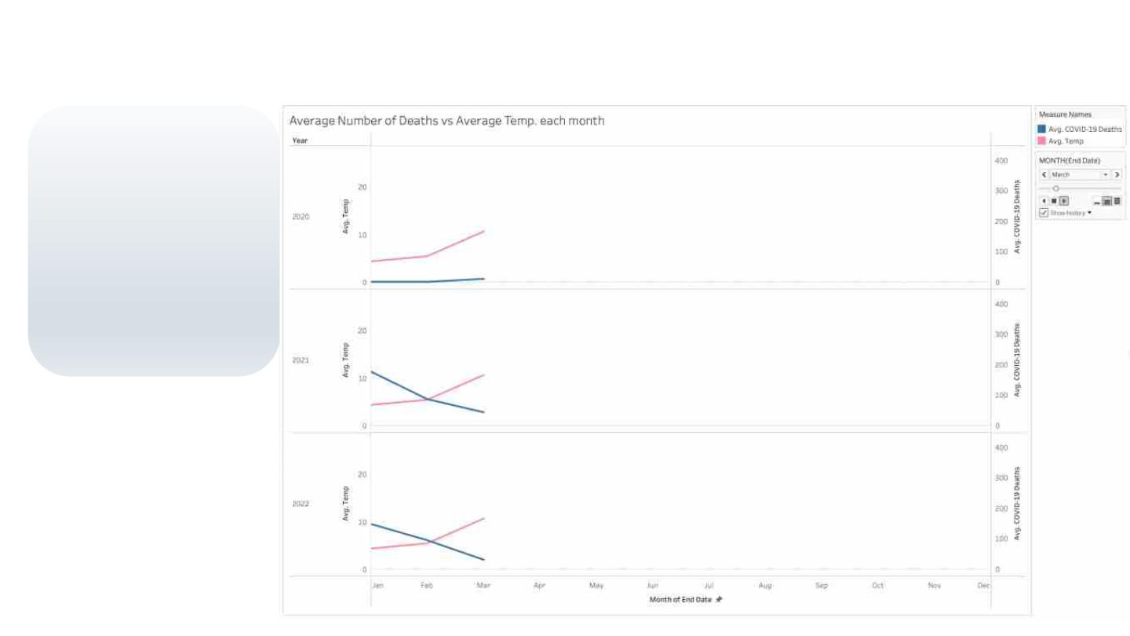
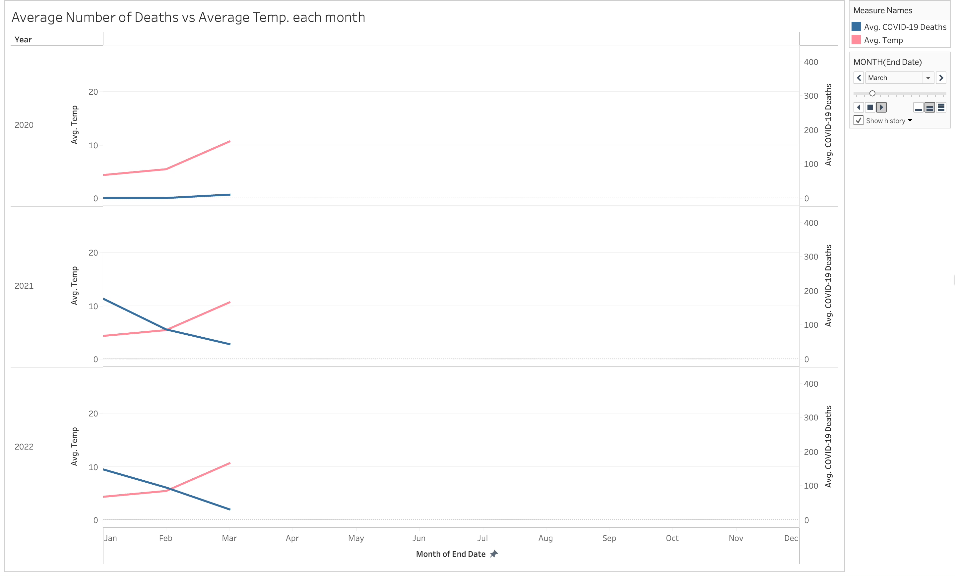
Hypothesis-4
Deaths due to COVID
are higher in December
and January when
compared to other
months
because covid
transmission rate is
higher in colder
weather.

Slide 12
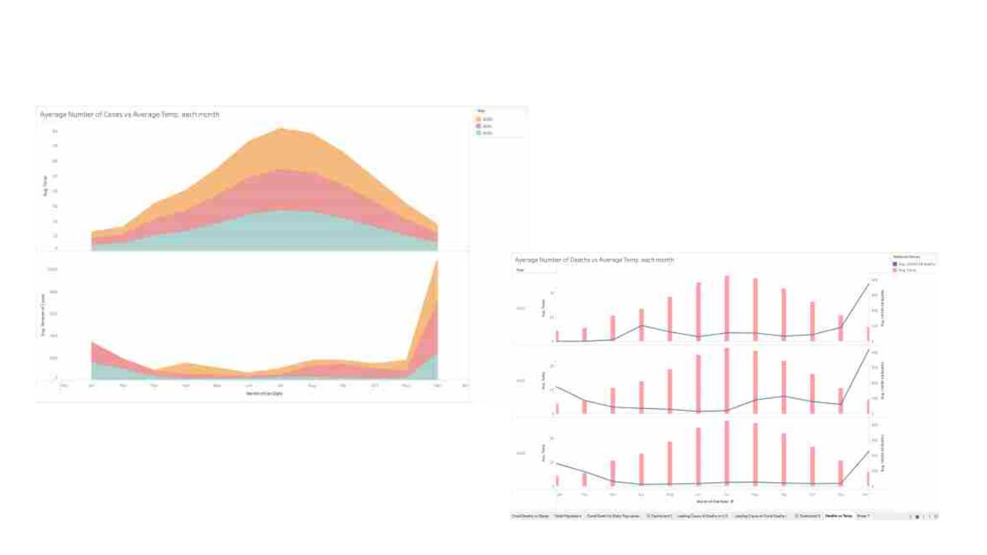
Hypothesis-4

Slide 13
Hypothesis-4
Final Verdict
The highest incidence of COVID cases
is typically observed in December, with
a subsequent stabilization or decrease
in cases by February
Our hypothesis is proven
TRUE.As transmission of
COVID increased in
lower temperature
months, number of
deaths also increased
There is a notable increase in COVID
related deaths during the month of
December, which may be attributed to
the colder temperature
Compared to high temperature
months, there is some evidence to
suggest COVID transmission is more
likely to occur during colder
temperature

Slide 14
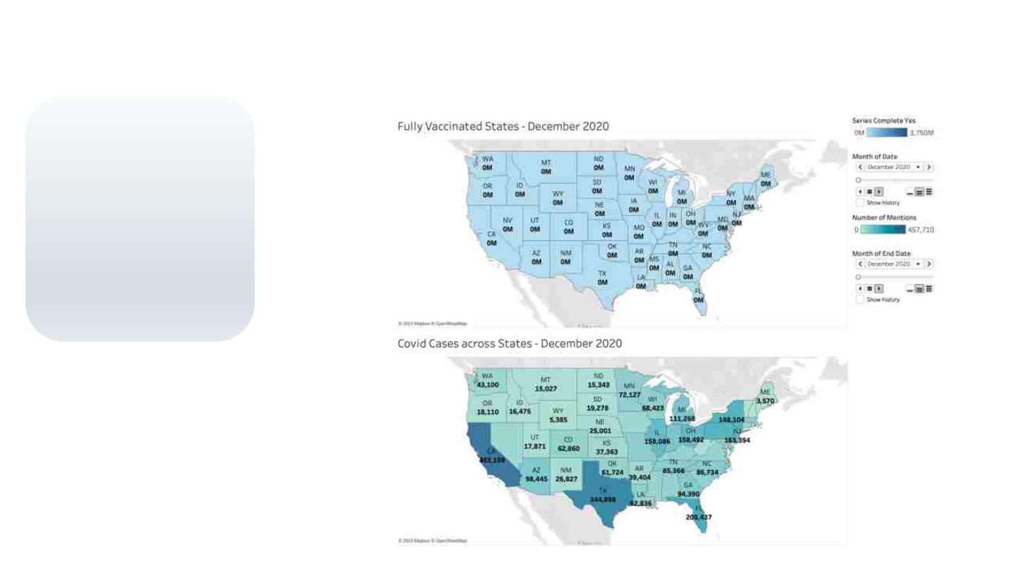
Hypothesis-5
COVID cases in 2022
got flattened when
compared to 2021
because a greater
proportion of Americans
were fully vaccinated by
2022.

Slide 15
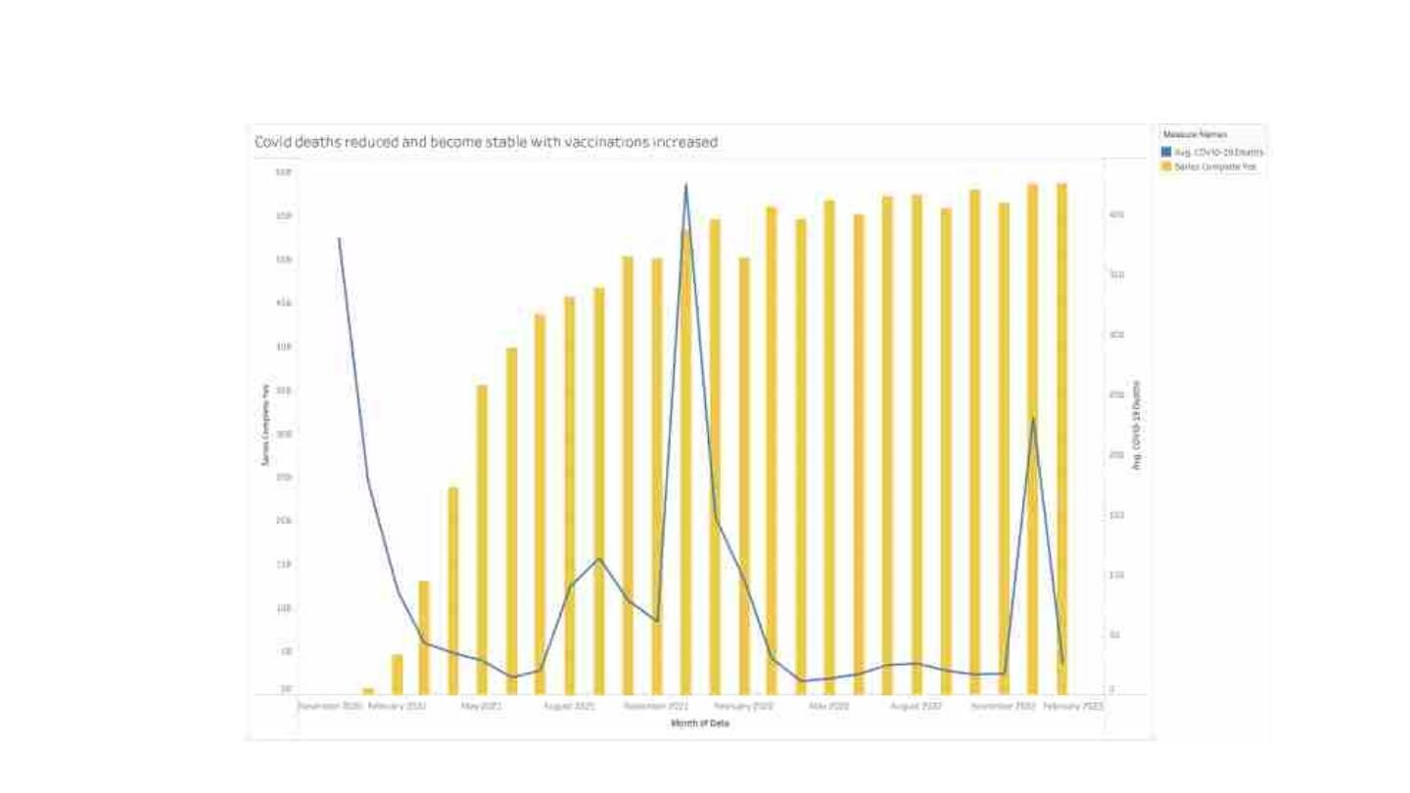
Hypothesis-5

Slide 16

Hypothesis-5
Final Verdict
Covid spread was very volatile at the
beginning of pandemic as there were
no remedy or vaccines produced.
As our hypothesis states,
we can conclude that covid
cases got flattened on the
year 2022 when compared
to 2021, as vaccinations
got introduced and
In the end of 2020 and beginning of
2021 increased as people become
vulnerable to disease without vaccine
administered to majority of
the Americans in 2022.

Slide 17

DATA SETS
https://data.cdc.gov/NCHS/Conditions-
Contributing-to-COVID-19-Deaths-by-Stat/hk9y-
quqm
https://www.census.gov/data/tables/time-
series/demo/popest/2020s-state-total.html
https://www.visualcrossing.com/weather/weat
her-data-services
https://www.cdc.gov/coronavirus/2019-
ncov/vaccines/reporting-vaccinations.html

Slide 18

THANK YOU

